Slide 1
Computer Science II Advanced C++
Spring 2018

Slide 2
Classes in C++
Intro to Object-Oriented Programming
Class as a concept
Objects as instances of classes

Slide 3
Useful Links to C++ tutorial
There are some useful hints and illustrations on classes in C++ at
http://www.cplusplus.com/doc/tutorial/classes/
on friendship and inheritance
http://www.cplusplus.com/doc/tutorial/inheritance/
and on polymorphism
http://www.cplusplus.com/doc/tutorial/polymorphism/

Slide 4
13.1
Procedural and Object-Oriented Programming

Slide 5
Procedural and Object-Oriented Programming
Procedural programming focuses on the process/actions that occur in a program
Object-Oriented programming is based on the data and the functions that operate on it. Objects are instances of ADTs that represent the data and its functions

Slide 6
Limitations of Procedural Programming
If the data structures change, many functions must also be changed
Programs that are based on complex function hierarchies are:
difficult to understand and maintain
difficult to modify and extend
easy to break

Slide 7
Classes in C++
A Class is an expanded concept of data structure: like data structures, classes can contain data members, but they can also contain functions as members
An object is an instant of a class
In terms of variables, a class would be the type, and an object would be the variable
The most important property of a class is that it is a type, and as such, we can declare multiple objects of it

Slide 8
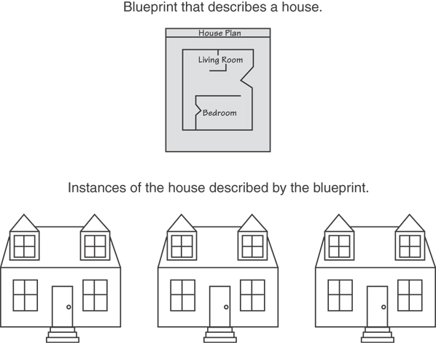
Classes and Objects
A Class is like a blueprint and objects are like houses built from the blueprint

Slide 9
Object-Oriented Programming Terminology
attributes: members of a class
methods or behaviors: member functions of a class

Slide 10
More on Objects
data hiding: restricting access to certain members of an object
public interface: members of an object that are available outside of the object. This allows the object to provide access to some data and functions without sharing its internal details and design, and provides some protection from data corruption

Slide 11
Introduction to Classes
Objects are created from a class
Format:
class ClassName
{
declaration;
declaration;
};

Slide 12
Classes in C++
Classes are defined using the keyword class with the following syntax:
where class_name is a valid identifier for the class, object_names is an optional list of names for objects of this class, which is their type
The body of the declaration can contain members, which can either be data or function declarations, and optionally access specifiers
class class_name
{
access_specifier_1:
member1;
access_specifier_2:
member2;
...
} object_names;

Slide 13
Access Specifiers
Used to control access to members of the class
public: can be accessed by functions outside of the class
private: can only be called by or accessed by functions that are members of the class. Cannot be accessed from outside of the class
protected: can only be called or accessed by functions that are members of the class and can also be called and accessed by functions that are members of the derived classes (to be considered later), but cannot be accessed from outside of the class

Slide 14
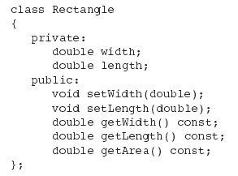
Class Example
Private Members
Public Members

Slide 15
More on Access Specifiers
Can be listed in any order in a class
Can appear multiple times in a class
If not specified, the default is private

Slide 16
Classes in C++
Classes have the same format as plain data structures, except that they can also include functions and have access specifiers
An access specifier is one of the following three keywords: private, public or protected. These specifiers modify the access rights for the members that follow them:
Private members of a class are accessible only from within other members of the same class
Protected members are accessible from other members of the same class (or from their "friends“– will be considered later), but also from members of their derived classes
Public members are accessible from anywhere where a corresponding object is visible

Slide 17
Classes in C++
By default, all members of a class declared with the class keyword have private access for all its members. Therefore, any member that is declared before any other access specifier has private access automatically. For example:
Declares a class (i.e., a type) called Rectangle and an object (i.e., a variable) of this class, called rect
This class contains four members: two data members of type int (member width and member height) with private access (because private is the default access level) and two member functions with public access: the functions set_values and area, of which for now we have only included their declaration, but not their definition
class Rectangle {
int width, height;
public:
void set_values (int,int);
int area (void);
} rect;

Slide 18
Classes in C++
After the declarations of Rectangle and rect, any of the public members of object rect can be accessed as if they were normal functions or normal variables, by simply inserting a dot (.) between object name and member name. This follows the same syntax as accessing the members of plain data structures. For example:
The only members of rect that cannot be accessed from outside the class are width and height, since they have private access and they can only be referred to from within other members of the same class
rect.set_values (3,4);
myarea = rect.area();

Slide 19
The complete example of class Rectangle-1
This example reintroduces the scope operator (:: double colon). Here it is used in the definition of function set_values to define a member of a class outside the class itself
Notice that the definition of the member function area has been included directly within the definition of class Rectangle given its extreme simplicity. Conversely, set_values it is merely declared with its prototype within the class, but it is explicitly defined later outside of the class
In this outside definition, the operator of scope (::) is used to specify that the function being defined is a member of the class Rectangle and not a regular non-member function
The scope operator (::) specifies the class to which the member being declared belongs, granting exactly the same scope properties as if this function definition was directly included within the class definition. For example, the function set_values has access to the variables width and height, which are private members of class Rectangle, and thus only accessible from other members of the class, such as this
// class example
#include <iostream>
using namespace std;
class Rectangle {
int width, height;
public:
void set_values (int,int); // func. declaration (prototype)
int area() // function definition
{return width*height;} // function area body
};
// definition of a member of a class outside the class itself
void Rectangle::set_values (int x, int y)
{
width = x;
height = y;
}
int main () {
Rectangle rect;
rect.set_values (3,4);
cout << "area: " << rect.area();
return 0;
}
Run
area: 12

Slide 20
Defining a Member Function
When defining a member function:
Put prototype in class declaration
Define function using class name and scope resolution operator (::)
int Rectangle::setWidth(double w)
{
width = w;
}

Slide 21
More on class member functions
The only difference between defining a member function completely within the class definition or to just include its prototype declaration there and define it later outside the class, is that in the first case the function is automatically considered an inline member function by the compiler, while in the second it is a normal (not-inline) class member function. This causes no differences in behavior, but only on possible compiler optimizations
Code for an inline function is copied into program in place of call – larger executable program, but no function call overhead, hence faster execution

Slide 22
More on class member functions
Members width and height have private access (remember that if nothing else is specified, all members of a class defined with keyword class have private access)
By declaring them private, access from outside the class is not allowed. This makes sense, since we have already defined a member function to set values for those members within the object: the member function set_values
Therefore, the rest of the program does not need to have direct access to them. Perhaps in a so simple example as this, it is difficult to see how restricting access to these variables may be useful, but in greater projects it may be very important that values cannot be modified in an unexpected way (unexpected from the point of view of the object)

Slide 23
Accessors and Mutators
Mutator: a member function that stores a value in a private member variable, or changes its value in some way
Accessor: function that retrieves a value from a private member variable. Accessors do not change an object's data, so they should be marked const.

Slide 24
The complete example of class Rectangle-2
The most important property of a class is that it is a type, and as such, we can declare multiple objects of it
For example, following with the previous example of class Rectangle, we could have declared the object rectb in addition to object rect
In this particular case, the class (type of the objects) is Rectangle, of which there are two instances (i.e., objects): rect and rectb. Each one of them has its own member variables and member functions
Notice that the call to rect.area() does not give the same result as the call to rectb.area()
// example: one class, two objects
#include <iostream>
using namespace std;
class Rectangle {
int width, height;
public:
void set_values (int,int); // declaration of function
int area () {return width*height;}
};
void Rectangle:: set_values (int x, int y) { //def. of funct.
width = x;
height = y;
}
int main () {
Rectangle rect, rectb; // declaration of objects
rect.set_values (3,4);
rectb.set_values (5,6);
cout << "rect area: " << rect.area() << endl;
cout << "rectb area: " << rectb.area() << endl;
return 0;
}
Run
rect area: 12
rectb area: 30

Slide 25
Classes and object-oriented programming
Classes allow programming using object-oriented paradigms:
Data and functions are both members of the object, reducing the need to pass and carry handlers or other state variables as arguments to functions, because they are parts of the object whose member is called
Notice that no arguments were passed on the calls to rect.area and rectb.area in the previous example. Those member functions directly used the data members of their respective objects rect and rectb

Slide 26
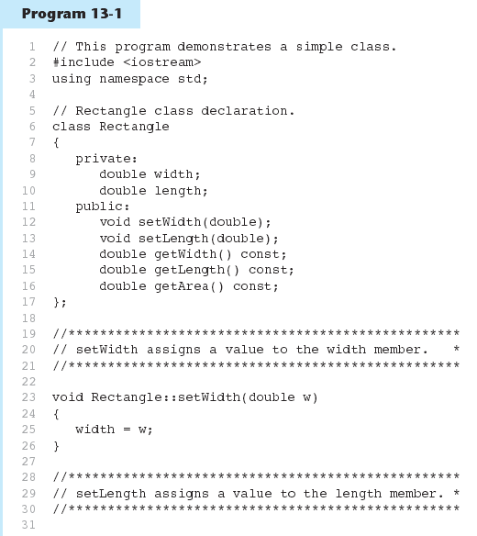

Slide 27
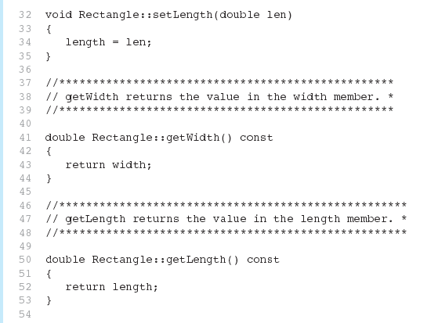
Program 13-1 (Continued)

Slide 28
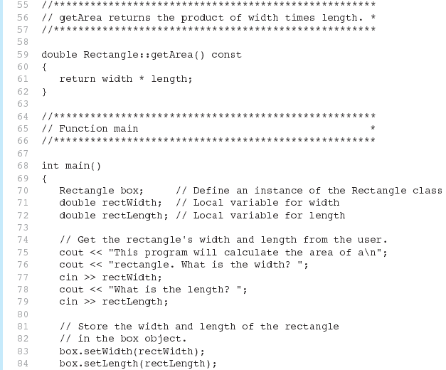
Program 13-1 (Continued)

Slide 29
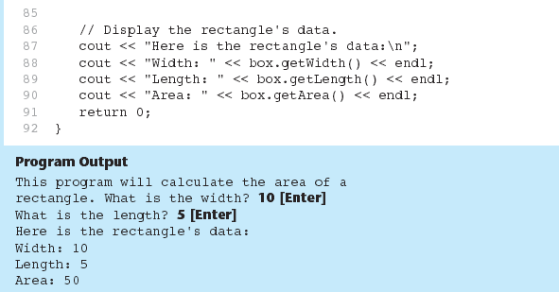
Program 13-1 (Continued)

Slide 30
Avoiding Stale Data
Some data is the result of a calculation.
In the Rectangle class the area of a rectangle is calculated.
length x width
If we were to use an area variable here in the Rectangle class, its value would be dependent on the length and the width.
If we change length or width without updating area, then area would become stale.
To avoid stale data, it is best to calculate the value of that data within a member function rather than store it in a variable.

Slide 31
Pointer to an Object
Can define a pointer to an object:
Rectangle *rPtr = nullptr;
Can access public members via pointer:
rPtr = &otherRectangle;
rPtr->setLength(12.5);
cout << rPtr->getLength() << endl;

Slide 32
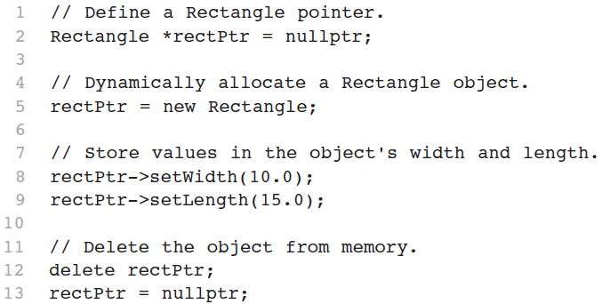
Dynamically Allocating an Object
We can also use a pointer to dynamically allocate an object.

Slide 33
Why Have Private Members?
Making data members private provides data protection
Data can be accessed only through public functions
Public functions define the class’s public interface

Slide 34
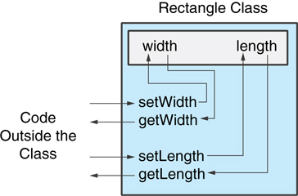
Code outside the class must use the class's public member functions to interact with the object.

Slide 35
Separating Specification from Implementation
Place class declaration in a header file that serves as the class specification file. Name the file ClassName.h, for example, Rectangle.h
Place member function definitions in ClassName.cpp, for example, Rectangle.cpp File should #include the class specification file
Programs that use the class must #include the class specification file, and be compiled and linked with the member function definitions

